Slide 1

ScapyUI - Network Packet Sniffer Tool
This presentation introduces ScapyUI, a user-friendly GUI-based network packet sniffer.
by Yash Rana

Slide 2

Project Overview
Title
ScapyUI – A GUI-Based Network Packet Sniffer
Presenter
Yash Rana
Course Info
M.Sc. Digital Forensics and Information Security
Guide & Institution
Mr. Harsh Panchal, NFSU Goa

Slide 3




Introduction to Packet Sniffing
Packet Sniffing
Importance
Captures and analyzes network traffic to monitor data flow.
Essential for network security and troubleshooting.
Tools
Scapy, Tkinter and npcap tools simplify packet analysis for users.

Slide 4

Problem Statement
CLI Limitations
Visual Feedback
Ease of use
Traditional sniffers are mostly command-line based.
Lack of intuitive visual interfaces for logs and traffic.
Tool is simple and does the work without much hassle.

Slide 5
Project Objectives
1
User-Friendly Interface
2
Real-Time Capture
3
Specific Protocol Display
Enable live capture of network packets.
Create an intuitive GUI sniffer accessible to all users.
Show HTTP and DNS traffic distinctly.
4
File Handling
5
Log Export
Read and analyze .pcap capture files.
Export captured logs to PDF for records.

Slide 6

Existing Systems Overview
Wireshark & Tshark
Usability Challenges
Widely used but have complex GUI or CLI interfaces.
Steep learning curve hinders beginner users.
Complexity
Multiple features can overwhelm new users.

Slide 7
Proposed System: ScapyUI
Technology Stack
Key Features
Python programming
Simplicity and modularity
Tkinter for GUI
Easy log export
Scapy for packet manipulation
Supports real-time traffic inspection

Slide 8
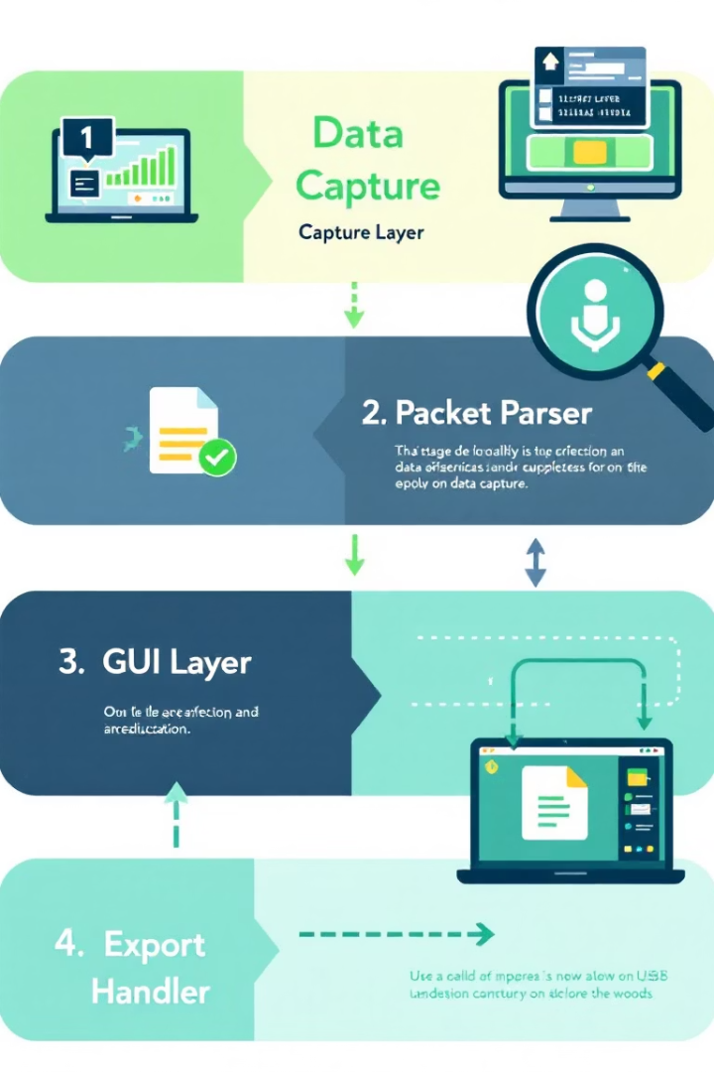




System Architecture Overview
Capture Layer
Interfaces with network to gather raw packets.
Packet Parser
Processes packets to extract meaningful data.
GUI Layer
Displays network traffic and enables interaction.
Export Handler
Manages log export to PDF files.

Slide 9
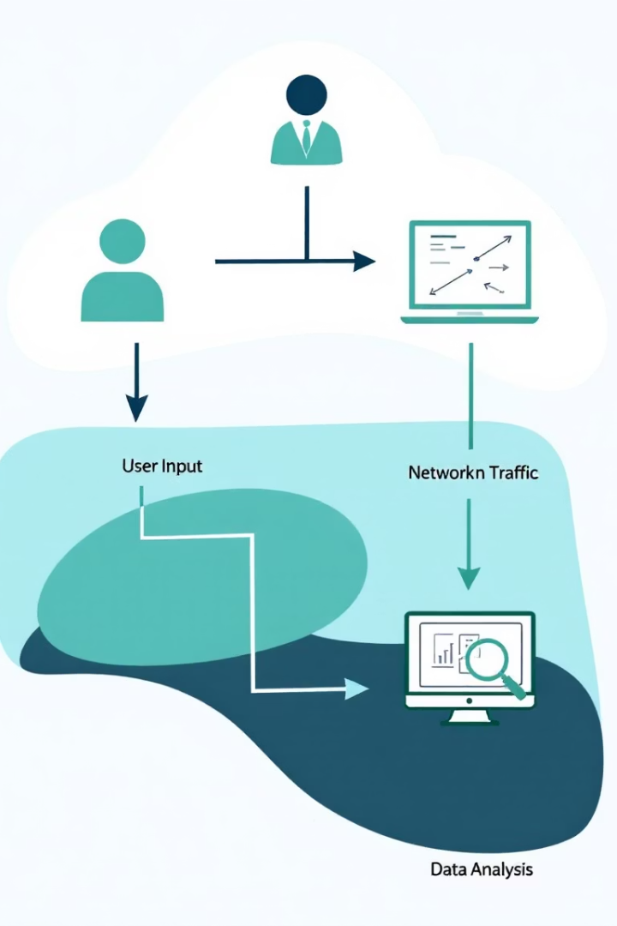
Use Case Diagram
User Role
Primary actor initiating packet captures and analysis.
Functionalities
Start/stop sniffing
View real-time HTTP and DNS packets
Load .pcap files
Export logs

Slide 10
Implementation
Tools Used: Python for logic, Scapy for packet handling
GUI: Built with Tkinter for intuitive user interaction
Real-Time Sniffing: Captures live network packets seamlessly
.pcap Support: Loads and analyzes saved capture files
Log Export: Generates PDF reports with reportlab library for documentation

Slide 11
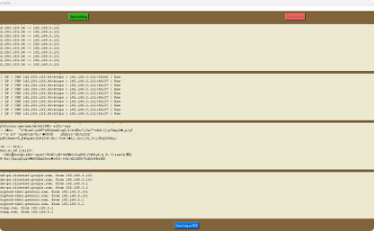
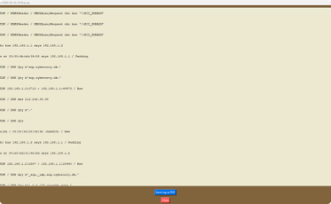
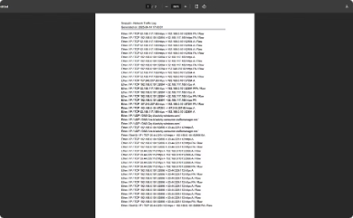
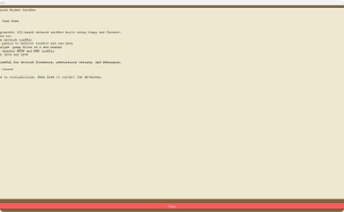
Output Screens
Main Window
.pcap Reader
Exported PDF
About Window
Shows real-time captured network traffic with protocol filters and summary stats.
Loads and analyzes saved capture files with detailed packet information display.
Well-formatted logs for documentation and record keeping, generated from captured data.
Provides details about the tool’s version, authorship, and contact information.

Slide 12



Results and Advantages
Broad Protocol Support
Modular Design
User Friendly
Enables easy maintenance and future feature expansion.
Intuitive interface ideal for students and researchers.
Captures IPv4, IPv6, TCP, UDP, ICMP, HTTP, and DNS packets seamlessly.

Slide 13
Future Scope
Packet Filtering Features: Add customizable filters for efficient packet capture.
Graphical Analytics: Visualize network data trends with interactive charts.
Hex Dump View:: Display the raw hexadecimal view of packet data for forensic purposes.
Security Alerting System: Real-time alerts for suspicious or malicious traffic detection.

Slide 14



Conclusion
Simple Yet Effective
Educational and Practical
Expansion Ready
Designed for ease of use while capturing essential packet data.
Modular design supports future feature additions and upgrades.
Balances learning with real-world network analysis utility.

Slide 15
Thank You
I appreciate your attention and interest in ScapyUI.
Please feel free to ask any questions or share feedback.

